Slide 1
Mental Health Tracker Web App
FYP Presentation – 2025
Emma Myo Nyunt
Supervisor
Dr Lilian G. Motti Ader
21/10/2025

Slide 2
Contents
Background
Objectives and target users
Methods
Expected results
Expected impact for the users
Timeline

Slide 3
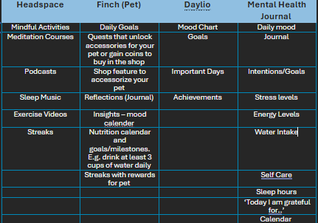
Background
Existing features
Mental Health:
rising need for improvement, post-pandemic shift
Self-care:
journaling, mood tracking, need for mindfulness
Young adults:
academic pressure, burnout

Slide 4
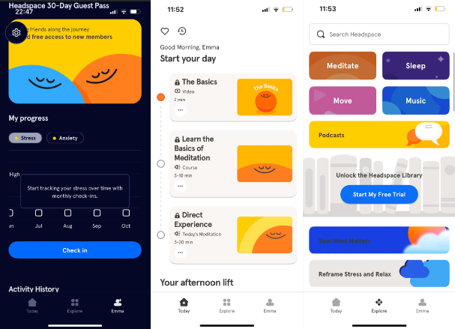
Headspace

Slide 5
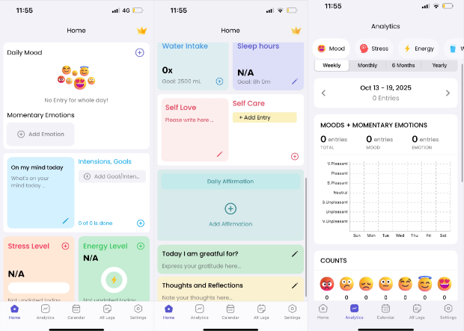
Mental Health Journal

Slide 6
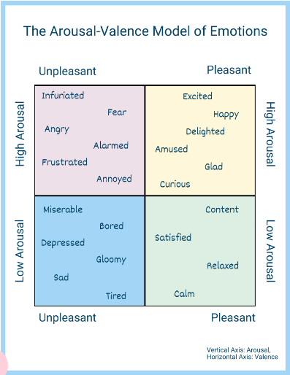
Background
Gaps I want to address:
Mixed emotions
Mobile-only access
Subscription barriers
Arousal-Valence Model:
Identifying and solving mixed emotions
Colours? Emojis?

Slide 7
Objectives
Build a responsive web app
Log moods, journaling
Visual summaries
Self-care tips (no psychological ed. Ref to HSE)
Aiming for simplicity, privacy, personalization
Target users: students and young adults

Slide 8
Methods
Use analysis of existing apps and literature
User research: studies of recent similar projects, what they actually want
Development:
Flask, HTML, CSS, JavaScript and Chart.js,
Hosting on Render for web app,
Continuous testing alongside development.

Slide 9
Methods
Prototype testing
Task 1: Sample entries
Task 2: Navigating the dashboard
Task 3: Wanted features
Task 4: Testing arousal-valence (mixed emotions)

Slide 10
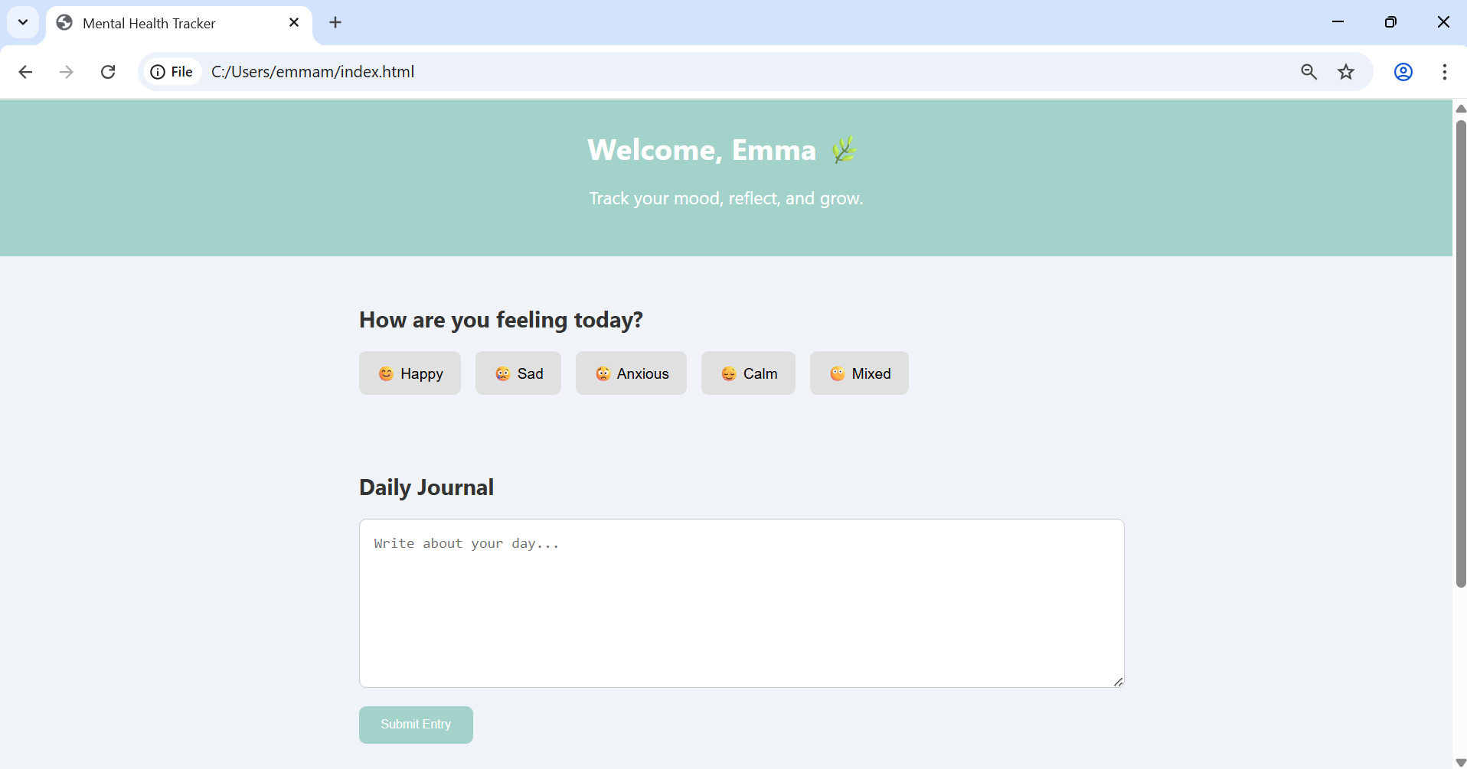
Some work to date

Slide 11
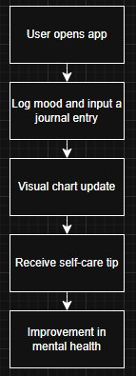
Expected results
What the final product would be (possible formats/look/feel)
Functional web app
Dashboard, charts, summaries
Clean, responsive UI
Comforting, soft colours
Gaps filled: Mixed emotions, mobile-only access, subscription barriers

Slide 12
Expected impact
Why this project is important, what would it bring to the users:
Encourages emotional awareness
Free and accessible
Increase in poor mental health in students/young adults

Slide 13
October, November
Initial research and planning
December
Project Timeline:
Development and testing occur simultaneously
Minimum of 5 participants per cycle
Begin prototype testing, web app development
January
Continue development, testing and start report
February
More testing, and development
March
Finalize web app, demo, fulfilling project requirements
April, May
Finalization of report and project

Slide 14
References
HSE: https://www2.hse.ie/mental-health/
Arousa-Valence Model of Emotions: https://neurodivergentinsights.com/arousal-valence-model/?srsltid=AfmBOopN-Lj6vfL9lLuqZlkzKVzjKRhhmvpsYr5TnDEkXaMdsLIMKpaa

Slide 15
Thanks for listening.
Questions?

